Slide 1


SEICHE 2022 Basic Arduino Programming
Instructor: Paul Frommeyer
www.paulfrommeyer.com
Corporate Sponsor: DXC Technology

Slide 2
Lesson Plan Overview
Lesson 1 – Intro and Setup [may require 2 classes]
Introduction to class format
Overview of lesson plan
Presentation format (monitor, camera, screen, whiteboard)
Review of microcontrollers and types of boards
SEICHE LED display architecture
ESP8266 pinout
High level architecture
Lesson 2 – Laptop operation review – Windows and Linux
Inventory of USB drives
Installation of Arduino IDE software
Installation of CH340/ESP8266 serial port drivers (Windows only)
Control panel/settings location
Home directories and folder hierarchy
Arduino file locations
Search functions
(Windows) Device Manager
(Linux) Konsole
Copying flash drive contents [critical]
Open questions and issues
IDE essentials
Starting the Arduino IDE
Basic Arduino sketch (program) structure
Loading example sketches
Loading and configuring new boards
Connecting boards
Identifying the microcontroller serial port
Linux
Windows
Lesson 3 – Libraries, Sketch structure, Serial Monitor, Variables, Binary Number System Pt1
Libraries
Sketch structure (A note on brace formatting)
The serial port monitor
Printing to the serial port monitor
Variables and the assignment operator
Binary number system Pt. 1.
Lesson 4/5 – The Binary Number System Cont. (may take 2-3 lessons)
Numerals vs numbers
Review: the base 10 system and digit place values
New: the base 2 system and digit place values
Bits and bytes and nybbles
Binary addition and subtraction
Formatting printed output
Shifting and exponents
Lesson 6/7 – Integers and Arithmetic Operators (may take 2 lessons)
The integer data type
Variables and the assignment operator
Autoincrement and autodecrement
Arithmetic Operators
Assigning arithmetic results to a variable
Bytes as data types
Lesson 8 – Communicating with Sensors
Reading a potentiometer
Reading a button
Initializing I2C sensors
Reading I2C sensors
Lesson 9 – Characters and Arrays
The hexadecimal number system
Representing characters as numbers
The ASCII character code
The char data type
Strings and character arrays
Lesson 10 – Comparison Operators
==, =>, <=
strcmp
Binary comparisons
Uploading a sketch to the microcontroller
Lesson 11 – Control Structures
if-then-else
while
for-next
Lesson 12 – Programming the LED matrix
Initializing the SPI interface
Controlling display brightness
Lighting and clearing a single pixel
Displaying text on the LED matrix
Default fonts
Nested for-next loops

Slide 3
Lesson 5 – Loading Binary Images; Arrays, Characters, Strings and Loops
Part A – Loading Binary Images
Windows Procedure for esptool
Linux procedure for esptool
Using esptool to load binary images
Part B
Arrays
Characters and character codes
Strings
Conditional Loops Part 1

Slide 4
Flashing Software Binaries
The Arduino IDE takes Processing/C++ source code and compiles it into a single binary file which is then transmitted to the microcontroller where it is stored in flash memory
Uploading of “raw” binary executable files to a microcontroller is called “flashing”
It is possible to create precompiled binaries and flash them without having to compile from source code or use the Arduino IDE
This is very, very similar to installing an app on a phone (and is identical to initially installing the operating system onto a phone, which is done at the factory)
We are going to learn how to do this ourselves!

Slide 5
Flashing ESP8266 Software on Linux
Exit the Arduino IDE and/or ensure it is NOT running
Assure you have copied the following file in today’s Lesson folder to your hard drive (use the Dolphin GUI file explorer; if you copied the whole Lesson 5 folder, you’re good to go, just make sure you can find the file) LEDMatrixDisplay-V7.1-d1_mini
Open a Konsole window, and enter the following command: which esptool
If your Linux system reports a path for the tool, you can skip to the installation step
If you do not have esptool installed, enter the following command into the Konsole window (enter your account password when/if prompted) sudo apt install esptool
One you have esptool installed, enter the following commands (you’ll need to interpolate the path for the directory where you placed the binary; if in doubt, just copy the binary to your Documents folder: cd [directory where the binary file is] esptool --port /dev/ttyUSB0 write_flash 0x0 ./ LEDMatrixDisplay-V7.1-d1_mini
Your ESP8266 display should restart and begin running the image you just uploaded!

Slide 6
Flashing on Windows with Python3
If you have a Windows workstation, you’ll need to install Python3 and then install esptool.py
Assure you have copied the following file in today’s Lesson folder to your hard drive (use the Windows file explorer; if you copied the whole Lesson 5 folder, you’re good to go, just make sure you can find the file) LEDMatrixDisplay-V7.1-d1_mini
For Windows 10/11, run the python-3.10.4-amd64 installer from the Software folder (copy it from your flash drive FIRST!)
Once Python is installed, open a CMD (DOS CLI) window
Enter the following commands into the DOS CLI prompt (you can skip the REM comments): pip install esptool REM Change to the directory you copied the WLED binaries to cd %userprofile%\Documents\folder_with_the_binary REM Connect your board and find the port it’s on with Device Mgr REM Then flash the bootloader first esptool.py --port COM?? write_flash 0x0 ./LEDMatrixDisplay-V7.1-d1_mini

Slide 7
Arrays
An array in C++ is a sequential series of data types accessed via an index
You can think of an array as working like a bunch of mailboxes at a large apartment building; each mailbox has a number corresponding to an apartment.
In C, what types of data that can be stored in the “mailbox” are determined by the data type of the array itself.
Like all other variables, arrays are declared, and they are declared like this: data_type variablename[number_of_storage_locations]
An actual example: int smallarray[5];
The previous statement declares smallarray as an array of type integer having five (5) storage locations, which we call members.

Slide 8
Working With Arrays
Element 1 | Element 2 | Element 3 | Element 4 | Element 5
The elements of an array are stored sequentially in memory
The index, then, determines how “far” into the array to “reach” to access a given element. This is called an offset.
Because the index is an offset, the first element is at zero offset from the beginning of the array.
With all of that in mind, we reference the first element like this: Serial.println(smallarray[0],DEC);
Remember that in C, zero always counts!

Slide 9
Working With Arrays (cont.)
Element 1 | Element 2 | Element 3 | Element 4 | Element 5
0 1 2 3 4
To access the fifth element of the array, we would use this syntax: smallarray[4] = 99;
If the concepts of offsets is confusing (and it can be!), an easier way to think of it is that the maximum index is always one less than the size of the array.
This works for all elements; the index is one less than the number of the element you want to use
Thus, the third element of the array has an index offset of two: smallarray[2]
Remember that in C, zero always counts!

Slide 10
Working With Arrays (cont.)
Element 1 | Element 2 | Element 3 | Element 4 | Element 5
0 1 2 3 4
We can fill an array when we declare it like this: int smallarray[4] = {10, 20, 30, 40};
An element of an array is the “underlying” data type making up the array. So smallarray[3] is an int.

Slide 11
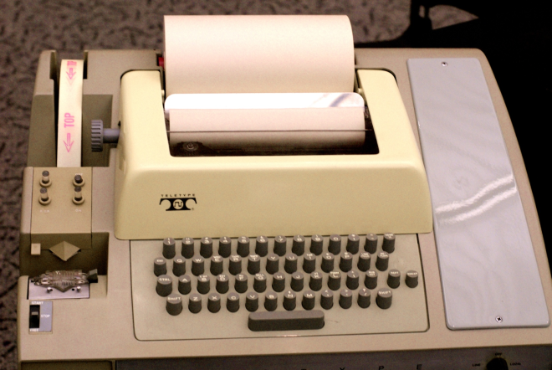
Character Encoding – Cyph3rpunks R001!
You may already be familiar with Morse code, which uses combinations of dots and dashes to represent each alphabetic character and numeral
Computer character encoding is based on historic, very simple ciphers used since ancient times to hide messages
You may have used this simple cipher when you were young kids, based on alphabetical position: A = 1, B = 2, C=3, etc.
Using that simple cipher, can you decode this ciphertext? 8 5 12 12 15 23 15 18 12 4
Since computers can only store ones and zeroes, we must have a way of “mapping” alphabetic characters– and printed numerals– into numbers the computer can store and retrieve.
In days of yore when electric typewriters were used instead of video terminals, it was also necessary to control the typewriter mechanism and cause it to return the print carriage to the left (carriage return) and feed the paper (line feed) etc.

Slide 12
Character Encoding – ASCII
Several schemes were tried at the dawn of the information age: Morse code, Baudot code, EBCDIC, and finally ASCII
ASCII – the American Standard Code for Information Interchange– ultimately became the cornerstone for worldwide computer character encoding.
ASCII was originally a seven bit code– it could only encode 127 characters; this was done due to memory limitations
ASCII was subsequently expanded to 8 bits, but the older 7-bit encodings are included in the 8-bit ASCII standard
Very roughly, 7-bit ASCII is divided up like this:
0 – 31 : Non-printing “control codes” used with physical teletype terminals and some video display terminals
32-126 : Alphanumeric characters
127 : The so-called “NUL” character that “does nothing”
128 – 255 : So-called “Extended” characters; international symbols, “text” graphics. These characters can, and often did, vary by terminal manufacturer

Slide 13
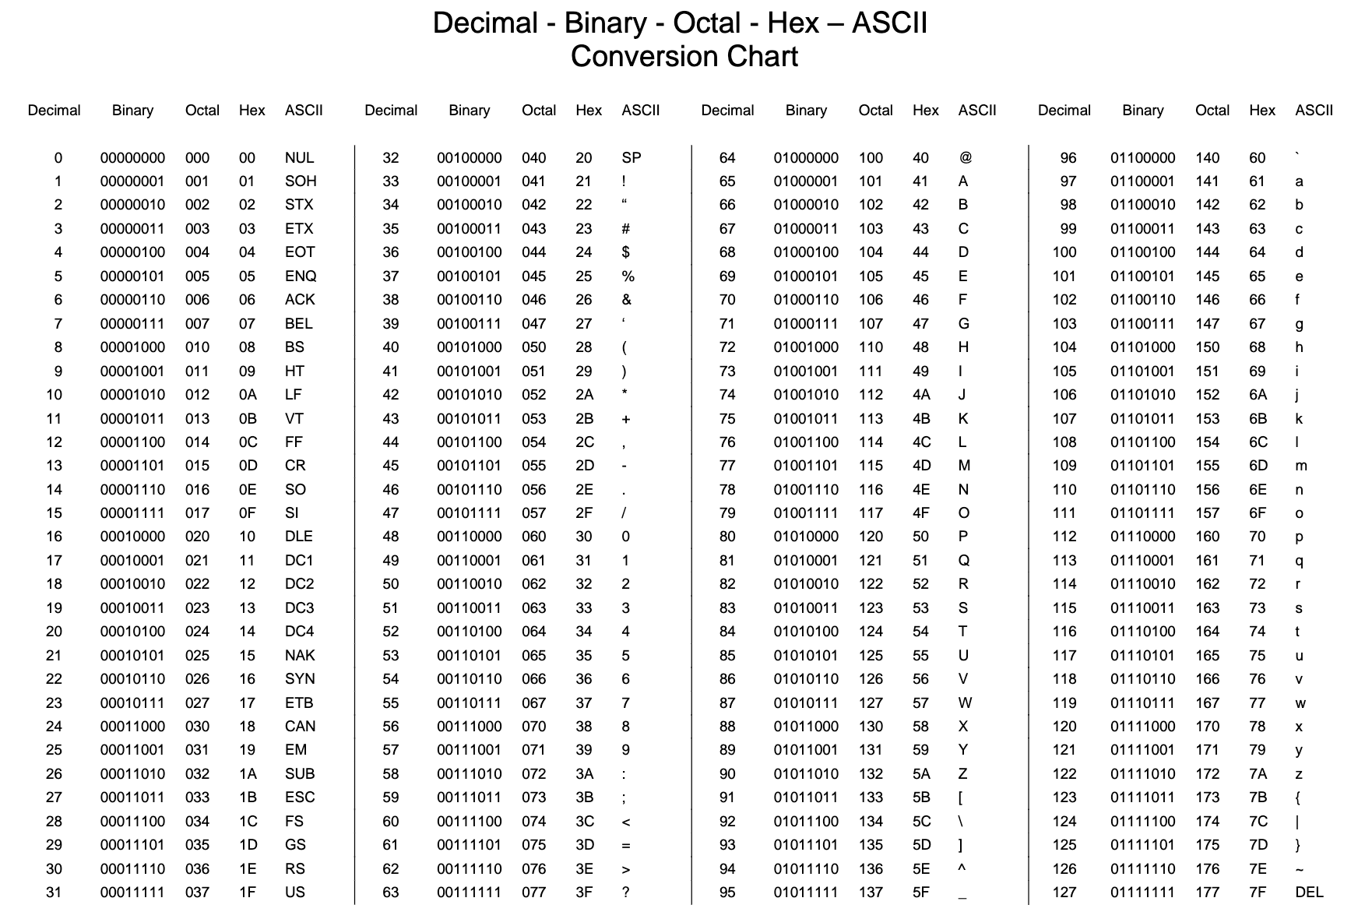
7-Bit ASCII Character Code

Slide 14
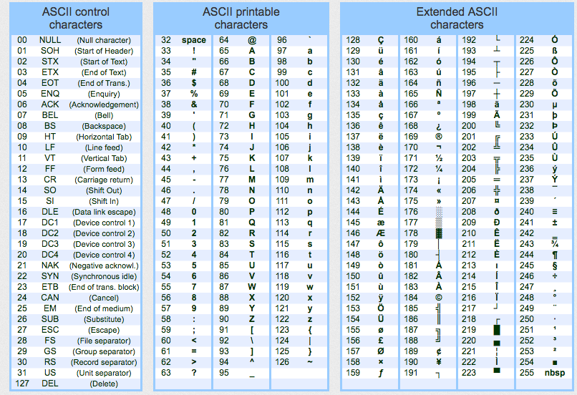
8-Bit ASCII Character Code

Slide 15
C and ASCII
Why do we care about ASCII? Because it’s how most computers store basic character data (there are more sophisticated character encodings, like UTF-8– we will study those next semester.)
You may have noticed that any of the numbers for the 255 characters of the extended 8-bit ASCII character set will “fit” in a single byte. This is not a coincidence.
Thus: A single byte of data can hold the number equivalent of any one of the 255 8-bit ASCII characters
The data type used to hold character data in C is char
Let’s see how that works!

Slide 16
Class Sketch 5A
Find and open Sketch5A.ino in your IDE
char aletter;
void setup()
{
// Setup port for serial monitor
Serial.begin(9600);
}
This time around, we will print the ASCII character set!
void loop()
{
Serial.println(aletter, DEC);
Serial.println(aletter,DEC);
Serial.println();
aletter++; // Wait, what?!
// Leave delay at 500 or higher to have output be readable
delay(500);
}
Describe your results. What is happening, and why?

Slide 17
Strings
In computer science, sequential groups of alphanumeric data are called “strings”. (Can’t call ‘em “words”, that’s another data type, right?)
Strings can contain numerals, letters, or any other valid ASCII character
In C, strings are implemented as arrays of type char. They are declared like this: char somestring[10].
Note that a string can only contain the number of characters it has been declared for!
There are two primary types of strings:
Raw ASCII data
Null-terminated

Slide 18
Strings (cont.)
Raw ASCII data strings are filled with whatever, and it’s up to the programmer to know when the string “ends”. There is no way to automagically “read through” the characters of a string.
Because it is hugely convenient to let the computer worry about pulling the individual characters out of a string array, the convention was developed to use the NULL character, ASCII 0, to terminate a string, that is, be the last character.
It’s the programmer’s job to ensure that there is a NULL terminating a string. This is a requirement for certain function calls and object methods, such as Serial.println(somestring);
Best practice is to add the NULL “as you go”
Arduino C++ offers a String datatype that is unique to the Arduino environment. It is very memory and processor intensive, thus not used often by developers, and is not portable to most C++ compilers, so is covered in this class (see “Choosing between Arduino Strings and C character arrays” in the Arduino Cookbook.) You are welcome to use it in your own code, however, and the Cookbook has good instructions on using it.

Slide 19
Relational Operators Redux
Last lesson we saw that the relational operators in C++ are:
Logical equals; this is done with a double equals sign: ==
Logical not equal; this is a negated equals sign: !=
Greater than; this is the (wait for it) greater-than sign: >
Less than; this is the (no surprise) less-than sign: <
Equal to or greater than: =>
Less than or equal to: <=
And, as you’ve already seen, a simple negation, !
This lesson, we are introducing two more. These are used to compare two logical expressions together:
&& Double ampersand is relational “and”. Evaluates to true if both expressions are true (foo < 30 && bar > 500)
|| Double “bar” or “pipe” is the relational “or”. Evaluates to true if either expression is true (mph == 88 || c == 300,000)

Slide 20
Conditional Loops Part 1
You are already familiar with the Loop() function in the IDE. This is an example of an endless or infinite loop, because it repeats indefinitely
Much more useful are conditional loops. Conditional loops execute until a logical conditional is (or isn’t) satisfied.
Today we will learn about the while loop, whose syntax is: while (conditional expr) statement;
when is usually used with a code block while (mph < 88) { Serial.println(a, DEC); mph++ }

Slide 21
While – Let’s Give It A Go
Let’s modify our sketch to use a while loop to only print the first 127 ASCII characters.
char aletter;
void setup()
{
// Setup port for serial monitor
Serial.begin(9600);
}
This time around, we will print the ASCII character set!
void loop()
{
aletter = 0;
while(aletter < 128)
{
Serial.println(aletter, DEC);
Serial.println(aletter,DEC);
Serial.println();
aletter++; delay(500);
}
}
Describe your results. What is happening, and why?

Slide 22
Formal End of Lesson 5
HOMEWORK!
Arduino Cookbook – Make sure you have read ALL of Chapter 2 and Chapter 3
A programming assignment! Yay! Take your homework sketch from last week and modify it to print the contents of an integer array of 99 elements, starting from the first element to the last, then from the last to the first. Use while instead of if-then. You’ll execute the sketch next week. Yeah, it’s another desk-checked exercise– although feel free to use a GNU C compiler locally if you just can’t wait. ☺
In next week’s exciting episode
For-Next Loops
Nested loops
Functions and parameters
Nested for-next loops
The binary number system (still assembling the slide deck!)

Slide 23
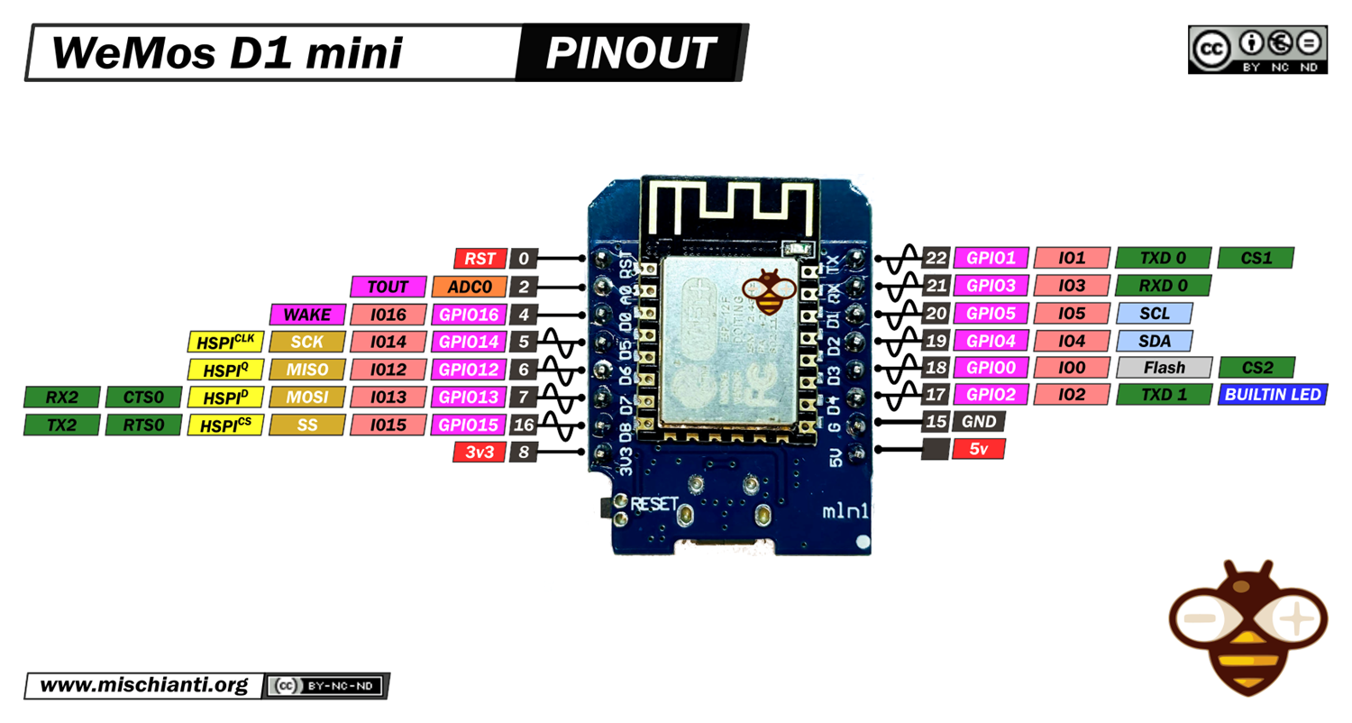
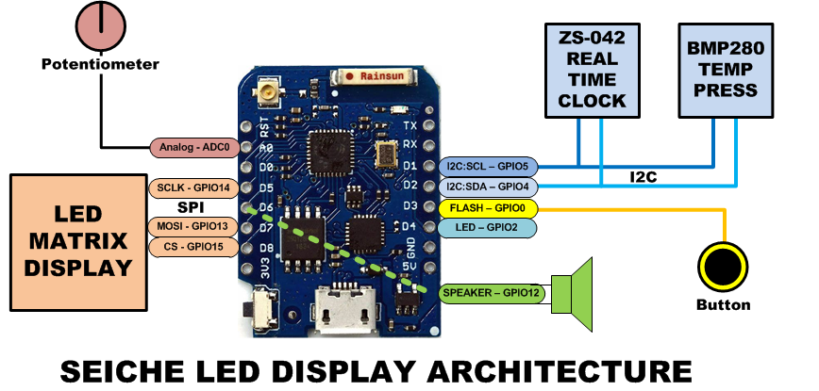
LESSON REFERENCE

Slide 24
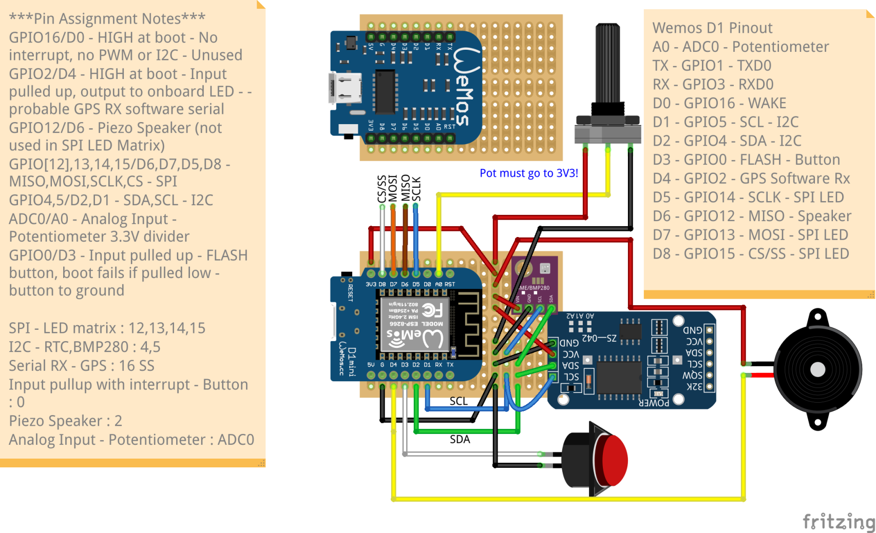
LESSON REFERENCE

